Slide 1
Security Incident Response

Slide 2
Incident Response
Its important to be prepared for a SUCCESSFUL attack on your system
You need to have a response ready when your system is breached.
Also, you need to address some important questions when coming up with a response plan.

Slide 3
Coming up with a Response Plan
Do you prosecute?
What’s the first thing you do when you detect that a host has been attacked?
Image the server
Whether & when you should rebuild the Server
What sort of forensic analysis will you carry out?

Slide 4
Do you prosecute?
Before you develop any other responses, the first thing you should decide is under what circumstances you will wish to prosecute an attacker.
Home office, might be never
Company, consult your legal department

Slide 5
Do you prosecute?
In either case:
It’s important to have an idea of what circumstances will prompt prosecution, because it will define the rest of the steps you can take.

Slide 6
How do you react immediately?
When you initially realise you’ve been attacked what’s the first thing you should do?
Pull the plug! Every command you run and every file you touch on the system potentially erases forensic clues you could use later. Plus, if the attacker has installed a root kit, you can’t even trust any output from the running machine.

Slide 7
Image the Server
Once you’ve pulled the plug,
Image the Server (create a replica):
That way you can then perform forensic analysis on the image without overwriting the original evidence.

Slide 8
Server Redeployment
You need to consider whether & when you will rebuild a server.
Best practice: rebuild a server whenever there has been a breach.
Unless you are skilled at forensic analysis it can be difficult to prove an attacker didn’t install a root kit or some sort of Trojan horse on the system. This means lot of things can be hidden from you.
Therefore – Rebuild the machine!

Slide 9
Forensics
Computer forensics is a vast topic and it can take years of work for you to become proficient.
However there are some basic steps you can try out yourself

Slide 10
Forensics
What you can do
Take the image of your attacked server to another host, mount it loopback and read-only, and then look around the mounted system for clues.
For more advanced forensic analysis you can use “Sleuth Kit”.

Slide 11
Forensics
Sleuth Kit
A complete set of forensics tools including a Web-based front end called Autopsy.
You can install them on your desktop using the package manager on it (the packages are called autopsy & sleuthkit)
Using a web browser you can configure & use Autopsy

Slide 12
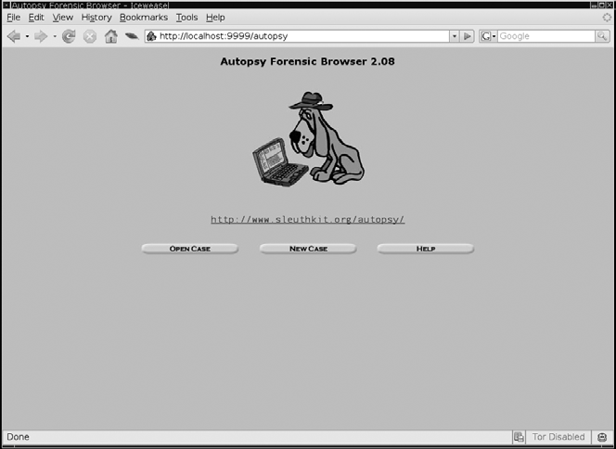
Forensics

Slide 13
Forensics
Sleuth Kit
From the default Autopsy page you can navigate through the tool, start a new investigation & add images to scan.
For more info:
http://wiki.sleuthkit.org/index.php?title=Autopsy_User’s_Guide

